Slide 1
Metode Riset Akuntansi
Measurement and Sampling

Slide 2
Measurement
Measurement in research consists of assigning numbers to empirical events, objects, or properties, or activities in compliance with a set of rules

Slide 3
Measurement
Selecting
measurable phenomena
Developing a set of
mapping rules
Applying the mapping rule
to each phenomenon
Notes:
Measurement in research consists of assigning numbers to empirical events, objects or properties, or activities in compliance with a set of rules. This slide illustrates the three-part process of measurement.
A mapping rule is a scheme for assigning numbers to aspects of an empirical event.

Slide 4
Measurement Scales
Several types of measurement are possible
  Depends on what you assume about mapping rule
Mapping rules have four characteristics:
  Classification
  Order
  Distance
  Origin

Slide 5
Types of Scales
Nominal
Ordinal
Interval
Ratio
Notes:
Students will be building their measurement questions from different types of scales. They need to know the difference in order to choose the appropriate type. Each scale type has its own characteristics.

Slide 6
Levels of Measurement
Nominal
Classification
Ordinal
Interval
Ratio
Notes:
This is a good time to ask students to develop a question they could ask that would provide only classification of the person answering it.
Classification means that numbers are used to group or sort responses.
Consider asking students if a number of anything is always an indication of ratio data. For example, what if we ask people how many cookies they eat a day? What if a business calls themselves the “number 1” pizza in town? These questions lead up to the next slide. Does the fact that James wears 23 mean he shoots better or plays better defense than the player donning jersey number 18?

Slide 7
Levels of Measurement
Nominal
Classification
Ordinal
Classification
Order
Interval
Ratio
Notes:
Order means that the numbers are ordered. One number is greater than, less than, or equal to another number.
You can ask students to develop a question that allows them to order the responses as well as group them. This is the perfect place to talk about the possible confusion that may exist when people order objects but the order may be the only consistent criteria. For instance, if two people tell them that Pizza Hut is better than Papa Johns, they are not necessarily thinking precisely the same. One could really favor Pizza Hut and never considering eating another Papa John’s pizza, which another could consider them almost interchangeable with only a slight preference for Pizza Hut. This discussion is a perfect lead in to the ever confusing ‘terror alert’ scale (shown on the next slide)…or the ‘weather warning’ system used in some states to keep drivers off the roads during poor weather. Students can probably come up with numerous other ordinal scales used in their environment.

Slide 8
Levels of Measurement
Nominal
Classification
Ordinal
Classification
Order
Interval
Classification
Distance
Order
Ratio
Notes:
In measuring, one devises some mapping rule and then translates the observation of property indicants using this rule.
Mapping rules have four characteristics and these are named in the slide.
Classification means that numbers are used to group or sort responses.
Order means that the numbers are ordered. One number is greater than, less than, or equal to another number.
Distance means that differences between numbers can be measured.
Origin means that the number series has a unique origin indicated by the number zero.
Combinations of these characteristics provide four widely used classifications of measurement scales: nominal, ordinal, interval, and ratio.

Slide 9
Levels of Measurement
Nominal
Classification
Ordinal
Classification
Order
Interval
Classification
Distance
Order
Ratio
Classification
Distance
Order
Natural Origin
Notes:
In measuring, one devises some mapping rule and then translates the observation of property indicants using this rule.
Mapping rules have four characteristics and these are named in the slide.
Classification means that numbers are used to group or sort responses.
Order means that the numbers are ordered. One number is greater than, less than, or equal to another number.
Distance means that differences between numbers can be measured.
Origin means that the number series has a unique origin indicated by the number zero.
Combinations of these characteristics provide four widely used classifications of measurement scales: nominal, ordinal, interval, and ratio.

Slide 10
Sources of Error
Respondent
Situation
Measurer
Instrument
Notes:
The ideal study should be designed and controlled for precise and unambiguous measurement of the variables. Since complete control is unattainable, error does occur. Much error is systematic (results from bias), while the remainder is random (occurs erratically).
Four major error sources may contaminate results and these are listed in the slide.
Opinion differences that affect measurement come from relatively stable characteristics of the respondent such as employee status, ethnic group membership, social class, and gender. Respondents may also suffer from temporary factors like fatigue and boredom.
Any condition that places a strain on the interview or measurement session can have serious effects on the interviewer-respondent rapport.
The interviewer can distort responses by rewording, paraphrasing, or reordering questions. Stereotypes in appearance and action also introduce bias. Careless mechanical processing will distort findings and can also introduce problems in the data analysis stage through incorrect coding, careless tabulation, and faulty statistical calculation.
A defective instrument can cause distortion in two ways. First, it can be too confusing and ambiguous. Second, it may not explore all the potentially important issues.

Slide 11
Evaluating
Measurement Tools
Validity
Criteria
Practicality
Reliability
Notes:
What are the characteristics of a good measurement tool? A tool should be an accurate indicator of what one needs to measure. It should be easy and efficient to use. There are three major criteria for evaluating a measurement tool.
Validity is the extent to which a test measures what we actually wish to measure.
Reliability refers to the accuracy and precision of a measurement procedure.
Practicality is concerned with a wide range of factors of economy, convenience, and interpretability.
These criteria are discussed further on the following slides.

Slide 12
Evaluating
Measurement Tools
Validity is the extent to which a test measures what we actually wish to measure
Reliability has to do with the accuracy and precision of a measurement procedure
Practicality is concerned with a wide range of factors of economy, convenience, and interpretability

Slide 13
Validity
Two major forms:
  External validity: data’s ability to be generalized
  Internal validity: the ability of a research instrument to measure what it is purported to measure

Slide 14
Validity Determinants
Content
Criterion
Construct
Notes:
There are three major forms of validity: content, construct, and criterion. Students need to know that they are in control of the level of validity of their own measurement.
Content validity refers to the extent to which measurement scales provide adequate coverage of the investigative questions. If the instrument contains a representative sample of the universe of subject matter of interest, then content validity is good. To evaluate content validity, one must first agree on what elements constitute adequate coverage. To determine content validity, one may use one’s own judgment and the judgment of a panel of experts.
Criterion-related validity reflects the success of measures used for prediction or estimation. There are two types of criterion-related validity: concurrent and predictive. These differ only on the time perspective. An attitude scale that correctly forecasts the outcome of a purchase decision has predictive validity. An observational method that correctly categorizes families by current income class has concurrent validity. Criterion validity is discussed further on the following slide.
Construct validity is a measurement scale that demonstrates both convergent validity and discriminant validity. In attempting to evaluate construct validity, one considers both the theory and measurement instrument being used. For instance, suppose we wanted to measure the effect of trust in relationship marketing. We would begin by correlating results obtained from our measure with those obtained from an established measure of trust. To the extent that the results were correlated, we would have indications of convergent validity. We could then correlate our results with the results of known measures of similar, but different measures such as empathy and reciprocity. To the extent that the results are not correlated, we can say we have shown discriminant validity.

Slide 15
Content Validity
The extent to which it provides adequate coverage of the investigative questions guiding the study

Slide 16
Increasing Content Validity
Content
Literature Search
Group Interviews
Expert Interviews
Notes:
Content validity refers to the extent to which measurement scales provide adequate coverage of the investigative questions. If the instrument contains a representative sample of the universe of subject matter of interest, then content validity is good. To evaluate content validity, one must first agree on what elements constitute adequate coverage. To determine content validity, one may use one’s own judgment and the judgment of a panel of experts.
Using the example of trust in relationship marketing, what would need to be included as measures of trust? Ask the students for their own ideas. To extend the questions included and to check for representativeness, students could check the literature on trust, conduct interviews with experts, conduct group interviews, check a database of questions, and so on.

Slide 17
Validity Determinants
Content
Construct
Notes:
Construct validity is a measurement scale that demonstrates both convergent validity and discriminant validity. In attempting to evaluate construct validity, one considers both the theory and measurement instrument being used. For instance, suppose we wanted to measure the effect of trust in relationship marketing. We would begin by correlating results obtained from our measure with those obtained from an established measure of trust. To the extent that the results were correlated, we would have indications of convergent validity. We could then correlate our results with the results of known measures of similar, but different measures such as empathy and reciprocity. To the extent that the results are not correlated, we can say we have shown discriminant validity.
This example is expanded upon in the following slide.

Slide 18
Construct Validity
Consider both theory and the measuring instrument being used

Slide 19
Validity Determinants
Content
Criterion
Construct
Notes:
Criterion-related validity reflects the success of measures used for prediction or estimation.
There are two types of criterion-related validity: concurrent and predictive. These differ only on the time perspective.
An attitude scale that correctly forecasts the outcome of a purchase decision has predictive validity.
An observational method that correctly categorizes families by current income class has concurrent validity.
Criterion validity is discussed further on the following slide.

Slide 20
Criterion-Related Validity
Reflects the success of measures used for prediction or estimation

Slide 21
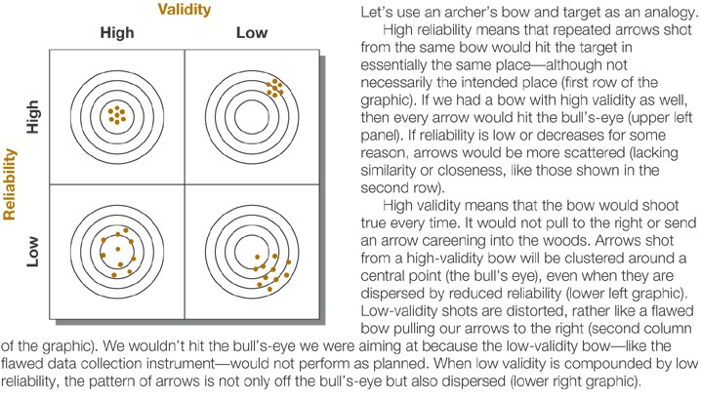
Understanding
Validity and Reliability
Notes:
Exhibit 12-6 illustrates reliability and validity by using an archer’s bow and target as an analogy. High reliability means that repeated arrows shot from the same bow would hit the target in essentially the same place. If we had a bow with high validity as well, then every arrow would hit the bull’s eye. If reliability is low, arrows would be more scattered. High validity means that the bow would shoot true every time. It would not pull right or send an arrow careening into the woods. Arrows shot from a high-validity bow will be clustered around a central point even when they are dispersed by reduced reliability.

Slide 22
Reliability Estimates
Stability
Internal
Consistency
Equivalence
Notes:
A measure is reliable to the degree that it supplies consistent results.
Reliability is a necessary contributor to validity but is not a sufficient condition for validity.
It is concerned with estimates of the degree to which a measurement is free of random or unstable error.
Reliable instruments are robust and work well at different times under different conditions. This distinction of time and condition is the basis for three perspectives on reliability – stability, equivalence, and internal consistency (see Exhibit 12-7).
These are discussed further on the following slide.

Slide 23
Practicality
Economy
Convenience
Interpretability
Notes:
The scientific requirements of a project call for the measurement process to be reliable and valid, while the operational requirements call for it to be practical.
Practicality has been defined as economy, convenience, and interpretability. There is generally a trade-off between the ideal research project and the budget.
A measuring device passes the convenience test if it is easy to administer.
The interpretability aspect of practicality is relevant when persons other than the test designers must interpret the results. In such cases, the designer of the data collection instrument provides several key pieces of information to make interpretation possible.
A statement of the functions the instrument was designed to measure and the procedures by which it was developed;
Detailed instructions for administration;
Scoring keys and instructions;
Norms for appropriate reference groups;
Evidence of reliability;
Evidence regarding the intercorrelations of subscores;
Evidence regarding the relationship of the test to other measures; and
Guides for test use.

Slide 24
Methods of Scaling
Rating scales
  Have several response categories and are used to elicit responses with regard to the object, event, or person studied.
Ranking scales
  Make comparisons between or among objects, events, persons and elicit the preferred choices and ranking among them.

Slide 25
Simple Category/Dichotomous Scale
I plan to purchase a MindWriter laptop in the
12 months.
Yes
No
Nominal Data
Notes:
This scale is also called a dichotomous scale. It offers two mutually exclusive response choices. In the example shown in the slide, the response choices are yes and no, but they could be other response choices too such as agree and disagree.

Slide 26
Multiple-Choice, Single Response Scale
What newspaper do you read most often for
financial news?
East City Gazette
West City Tribune
Regional newspaper
National newspaper
Other (specify:_____________)
Nominal Data
Notes:
When there are multiple options for the rater but only one answer is sought, the multiple-choice, single-response scale is appropriate. The other response may be omitted when exhaustiveness of categories is not critical or there is no possibility for an other response. This scale produces nominal data.

Slide 27
Multiple-Choice, Multiple Response Scale
What sources did you use when designing your new
home? Please check all that apply.
Online planning services
Magazines
Independent contractor/builder
Designer
Architect
Other (specify:_____________)
Nominal Data
Notes:
This scale is a variation of the last and is called a checklist. It allows the rater to select one or several alternatives. The cumulative feature of this scale can be beneficial when a complete picture of the participant’s choice is desired, but it may also present a problem for reporting when research sponsors expect the responses to sum to 100 percent. This scale generates nominal data.

Slide 28
Likert Scale
The Internet is superior to traditional libraries for
comprehensive searches.
Strongly disagree
Disagree
Neither agree nor disagree
Agree
Strongly agree
Interval Data
Notes:
The Likert scale was developed by Rensis Likert and is the most frequently used variation of the summated rating scale. Summated rating scales consist of statements that express either a favorable or unfavorable attitude toward the object of interest. The participant is asked to agree or disagree with each statement. Each response is given a numerical score to reflect its degree of attitudinal favorableness and the scores may be summed to measure the participant’s overall attitude. Likert scales may use 5, 7, or 9 scale points. They are quick and easy to construct. The scale produces interval data.
Originally, creating a Likert scale involved a procedure known as item analysis. Item analysis assesses each item based on how well it discriminates between those people whose total score is high and those whose total score is low. It involves calculating the mean scores for each scale item among the low scorers and the high scorers. The mean scores for the high-score and low-score groups are then tested for statistical significance by computing t values. After finding the t values for each statement, they are rank-ordered, and those statements with the highest t values are selected. Researchers have found that a larger number of items for each attitude object improves the reliability of the scale.

Slide 29
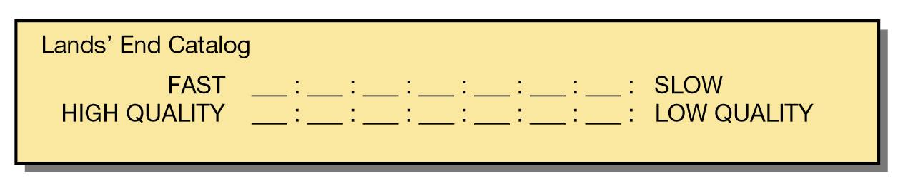
Semantic Differential
Interval Data
Notes:
The semantic differential scale measures the psychological meanings of an attitude object using bipolar adjectives. Researchers use this scale for studies of brand and institutional image. The method consists of a set of bipolar rating scales, usually with 7 points, by which one or more participants rate one or more concepts on each scale item. The scale is based on the proposition that an object can have several dimensions of connotative meaning. The meanings are located in multidimensional property space, called semantic space.
It is efficient and easy for securing attitudes from a large sample. Attitudes may be measured in both direction and intensity. The total set of responses provides a comprehensive picture of the meaning of an object and a measure of the person doing the rating. It is standardized and produces interval data.
Exhibit 13-6 provides basic instructions for constructing an SD scale.

Slide 30
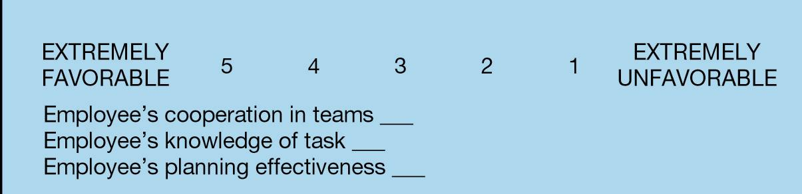
Numerical Scale
Ordinal or Interval Data
Notes:
Numerical scales have equal intervals that separate their numeric scale points. The verbal anchors serve as the labels for the extreme points. Numerical scales are often 5-point scales but may have 7 or 10 points. The participants write a number from the scale next to each item. It produces either ordinal or interval data.

Slide 31
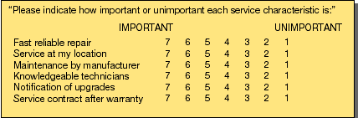
Multiple Rating List Scales
Interval Data
Notes:
A multiple rating scale is similar to the numerical scale but differs in two ways: 1) it accepts a circled response from the rater, and 2) the layout facilitates visualization of the results. The advantage is that a mental map of the participant’s evaluations is evident to both the rater and the researcher. This scale produces interval data.

Slide 32
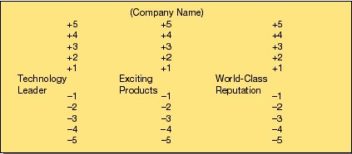
Stapel Scales
Interval Data
Notes:
The Stapel scale is used as an alternative to the semantic differential, especially when it is difficult to find bipolar adjectives that match the investigative question. In the example, there are three attributes of corporate image. The scale is composed of the word identifying the image dimension and a set of 10 response categories for each of the three attributes. Stapel scales produce interval data.

Slide 33
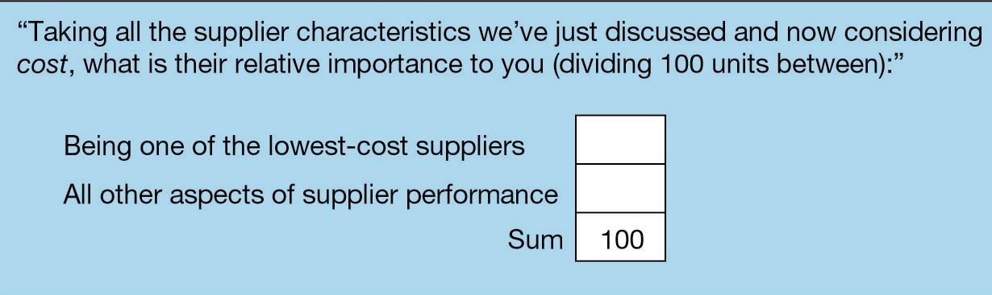
Constant-Sum Scales
Interval Data
Notes:
The constant-sum scale helps researchers to discover proportions. The participant allocates points to more than one attribute or property indicant, such that they total a constant sum, usually 100 or 10.
Participant precision and patience suffer when too many stimuli are proportioned and summed. A participant’s ability to add may also be taxed. Its advantage is its compatibility with percent and the fact that alternatives that are perceived to be equal can be so scored. This scale produces interval data.

Slide 34
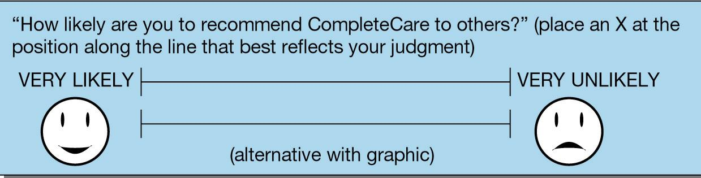
Graphic Rating Scales
Interval Data
Notes:
The graphic rating scale was originally created to enable researchers to discern fine differences. Theoretically, an infinite number of ratings is possible if participants are sophisticated enough to differentiate and record them. They are instructed to mark their response at any point along a continuum. Usually, the score is a measure of length from either endpoint. The results are treated as interval data. The difficulty is in coding and analysis. Other graphic rating scales use pictures, icons, or other visuals to communicate with the rater and represent a variety of data types. Graphic scales are often used with children.

Slide 35
Ranking Scales
Paired-comparison scale
Forced ranking scale
Comparative scale
Notes:
In ranking scales, the participant directly compares two or more objects and makes choices among them. The participant may be asked to select one as the best or most preferred.

Slide 36
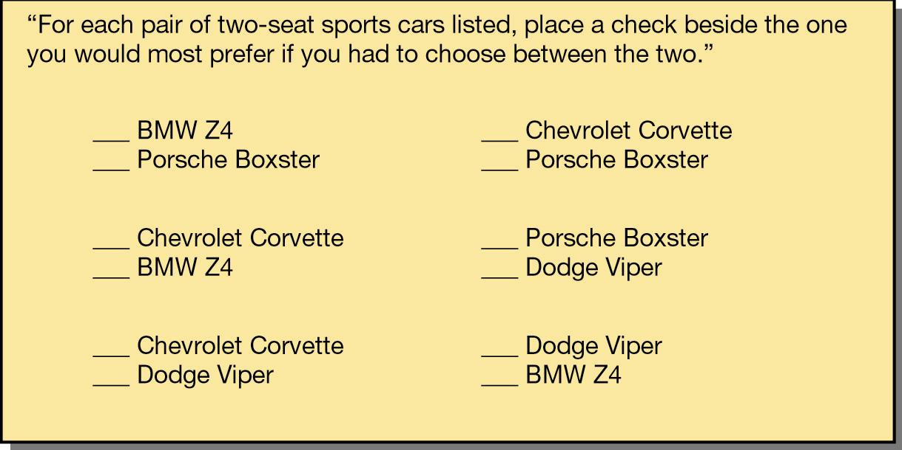
Paired-Comparison Scale
Ordinal Data
Notes:
Using the paired-comparison scale, the participant can express attitudes unambiguously by choosing between two objects. The number of judgments required in a paired comparison is [(n)(n-1)/2], where n is the number of stimuli or objects to be judged. Paired comparisons run the risk that participants will tire to the point that they give ill-considered answers or refuse to continue. Paired comparisons provide ordinal data.

Slide 37
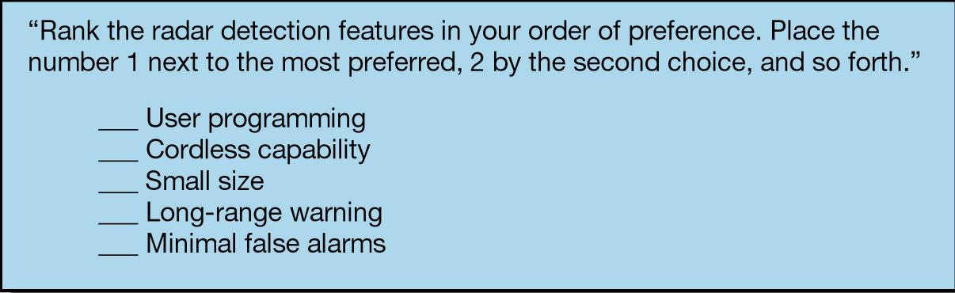
Forced Ranking Scale
Ordinal Data
Notes:
The forced ranking scale lists attributes that are ranked relative to each other. This method is faster than paired comparisons and is usually easier and more motivating to the participant. With five item, it takes ten paired comparisons to complete the task, but the simple forced ranking of five is easier. A drawback of this scale is the number of stimuli that can be handed by the participant. This scale produces ordinal data.

Slide 38
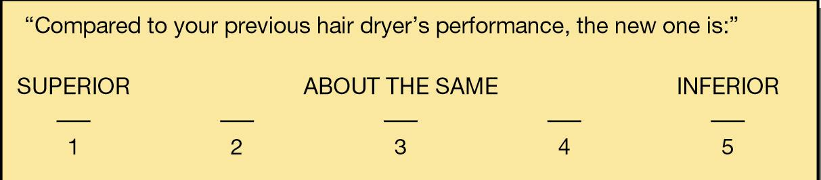
Comparative Scale
Ordinal or Interval Data
Notes:
When using a comparative scale, the participant compares an object against a standard. The comparative scale is ideal for such comparisons if the participants are familiar with the standard. Some researchers treat the data produced by comparative scales as interval data since the scoring reflects an interval between the standard and what is being compared, but the text recommends treating the data as ordinal unless the linearity of the variables in question can be supported.

Slide 39
The Nature of Sampling
The basic idea of sampling is that by selecting some of the elements in a population, we may draw conclusions about the entire population

Slide 40
The Nature of Sampling
Population element: the individual participant or object on which the measurement is taken
Population: total collection of elements about which we wish to make some inferences
Census: a count of all the elements in a population
Sample frame: listing of all population elements from which the sample will be drawn

Slide 41
Why Sample?
Availability of elements
Lower cost
Sampling
provides
Greater speed
Greater accuracy
Notes:
This slide lists the reasons researchers use a sample rather than a census.

Slide 42
What Is A Good Sample?
Accuracy
Precision
Notes:
The ultimate test of a sample design is how well it represents the characteristics of the population it purports to represent. In measurement terms, the sample must be valid. Validity of a sample depends on two considerations: accuracy and precision.
Accuracy is the degree to which bias is absent from the sample. When the sample is drawn properly, the measure of behavior, attitudes, or knowledge of some sample elements will be less than the measure of those same variables drawn from the population. The measure of other sample elements will be more than the population values. Variations in these sample values offset each other, resulting in a sample value that is close to the population value. For these offsetting effects to occur, there must be enough elements in the sample and they must be drawn in a way that favors neither overestimation nor underestimation. Increasing the sample size can reduce systematic variance as a cause of error. Systematic variance is a variation that causes measurements to skew in one direction or another.
Precision of estimate is the second criterion of a good sample design. The numerical descriptors that describe samples may be expected to differ from those that describe populations because of random fluctuations inherent in the sampling process. This is called sampling error and reflects the influence of chance in drawing the sample members. Sampling error is what is left after all known sources of systematic variance have been accounted for.
Precision is measured by the standard error of estimate, a type of standard deviation measurement. The smaller the standard error of the estimate, the higher is the precision of the sample.

Slide 43
Accuracy
Accuracy is the degree to which bias is absent from the sample
  Systematic variance
  Increasing the sample size

Slide 44
Precision
A measure of how closely the sample represents the population
  Measured by the standard error of estimate

Slide 45
Sampling Designs
Probability sampling
  Elements in the population have some known chance or probability of being selected as sample subjects
Nonprobability sampling
  Elements do not have known or predetermined chance of being selected as subjects

Slide 46
Types of Sampling Designs
Element Selection | Probability | Nonprobability
Unrestricted | Simple random | Convenience
Restricted | Complex random | Purposive
 | Systematic | Judgment
 | Cluster | Quota
 | Stratified | Snowball
 | Double
Notes:
The members of a sample are selected using probability or nonprobability procedures. Nonprobability sampling is an arbitrary and subjective sampling procedure where each population element does not have a known, nonzero chance of being included.
Probability sampling is a controlled, randomized procedure that assures that each population element is given a known, nonzero chance of selection.

Slide 47
Simple Random
Purest form of probability sampling

Slide 48
Simple Random
Advantages
Easy to implement
Disadvantages
Requires list of population elements
Time consuming
Can require larger sample sizes
Notes:
In drawing a sample with simple random sampling, each population element has an equal chance of being selected into the samples. The sample is drawn using a random number table or generator. This slide shows the advantages and disadvantages of using this method.
The probability of selection is equal to the sample size divided by the population size.
Exhibit 15-4 covers how to choose a random sample. The steps are as follows:
Assign each element within the sampling frame a unique number.
Identify a random start from the random number table.
Determine how the digits in the random number table will be assigned to the sampling frame.
Select the sample elements from the sampling frame.

Slide 49
Systematic
Every kth element in the population is sampled, beginning with a random start of an element in the range of 1 to k

Slide 50
Systematic
Advantages
Simple to design
Easier than simple random
Disadvantages
Periodicity within population may skew sample and results
Trends in list may bias results
Notes:
In drawing a sample with systematic sampling, an element of the population is selected at the beginning with a random start and then every Kth element is selected until the appropriate size is selected.
The kth element is the skip interval, the interval between sample elements drawn from a sample frame in systematic sampling. It is determined by dividing the population size by the sample size.
To draw a systematic sample, the steps are as follows:
Identify, list, and number the elements in the population
Identify the skip interval
Identify the random start
Draw a sample by choosing every kth entry.
To protect against subtle biases, the research can
Randomize the population before sampling,
Change the random start several times in the process, and
Replicate a selection of different samples.

Slide 51
Stratified
The process by which the sample is constrained to include elements from each of the segments

Slide 52
Stratified
Advantages
Increased statistical efficiency
Provides data to represent and analyze subgroups
Enables use of different methods in strata
Disadvantages
Especially expensive if strata on population must be created
Notes:
In drawing a sample with stratified sampling, the population is divided into subpopulations or strata and uses simple random on each strata. Results may be weighted or combined. The cost is high.
Stratified sampling may be proportion or disproportionate. In proportionate stratified sampling, each stratum’s size is proportionate to the stratum’s share of the population.
Any stratification that departs from the proportionate relationship is disproportionate.

Slide 53
Stratified
Proportionate: sample drawn from the stratum is proportionate to the stratum’s share of the total population
Disproportionate

Slide 54
Cluster
Advantages
Economically more efficient than simple random
Easy to do without list
Disadvantages
Often lower statistical efficiency due to subgroups being homogeneous rather than heterogeneous
Notes:
In drawing a sample with cluster sampling, the population is divided into internally heterogeneous subgroups. Some are randomly selected for further study.
Two conditions foster the use of cluster sampling:
the need for more economic efficiency than can be provided by simple random sampling, and
2) the frequent unavailability of a practical sampling frame for individual elements.
Exhibit 15-5 provides a comparison of stratified and cluster sampling and is highlighted on the next slide.
Several questions must be answered when designing cluster samples.
How homogeneous are the resulting clusters?
Shall we seek equal-sized or unequal-sized clusters?
How large a cluster shall we take?
Shall we use a single-stage or multistage cluster?
How large a sample is needed?

Slide 55
Stratified and Cluster Sampling
Stratified
Population divided into few subgroups
Homogeneity within subgroups
Heterogeneity between subgroups
Choice of elements from within each subgroup
Cluster
Population divided into many subgroups
Heterogeneity within subgroups
Homogeneity between subgroups
Random choice of subgroups

Slide 56
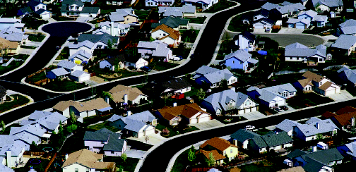
Area Sampling
Notes:
Area sampling is a cluster sampling technique applied to a population with well-defined political or geographic boundaries. It is a low-cost and frequently used method.

Slide 57
Double
It may be more convenient or economical to collect some information by sample and then use this information as the basis for selecting a subsample for further study

Slide 58
Double
Advantages
May reduce costs if first stage results in enough data to stratify or cluster the population
Disadvantages
Increased costs if discriminately used
Notes:
In drawing a sample with double (sequential or multiphase) sampling, data are collected using a previously defined technique. Based on the information found, a subsample is selected for further study.

Slide 59
Nonprobability Sampling
No need to generalize
Feasibility
Limited objectives
Issues
Time
Cost
Notes:
With a subjective approach like nonprobability sampling, the probability of selecting population elements is unknown. There is a greater opportunity for bias to enter the sample and distort findings. We cannot estimate any range within which to expect the population parameter. Despite these disadvantages, there are practical reasons to use nonprobability samples.
When the research does not require generalization to a population parameter, then there is no need to ensure that the sample fully reflects the population. The researcher may have limited objectives such as those in exploratory research. It is less expensive to use nonprobability sampling. It also requires less time. Finally, a list may not be available.

Slide 60

Nonprobability
Sampling Methods
Convenience
Judgment
Quota
Snowball
Notes:
Convenience samples are nonprobability samples where the element selection is based on ease of accessibility. They are the least reliable but cheapest and easiest to conduct. Examples include informal pools of friends and neighbors, people responding to an advertised invitation, and “on the street” interviews.
Judgment sampling is purposive sampling where the researcher arbitrarily selects sample units to conform to some criterion. This is appropriate for the early stages of an exploratory study.
Quota sampling is also a type of purposive sampling. In this type, relevant characteristics are used to stratify the sample which should improve its representativeness. The logic behind quota sampling is that certain relevant characteristics describe the dimensions of the population. In most quota samples, researchers specify more than one control dimension. Each dimension should have a distribution in the population that can be estimated and be pertinent to the topic studied.
Snowball sampling means that subsequent participants are referred by the current sample elements. This is useful when respondents are difficult to identify and best located through referral networks. It is also used frequently in qualitative studies.

Slide 61
Convenience
Collection of information from members of the population who are conveniently available to provide it

Slide 62
Purposive
Conform to some criteria set by the researcher
  Judgment sampling
  Quota sampling

Slide 63
Snowball
Individuals are discovered and this group is then used to refer the researcher to others that possess similar characteristics and who, in turn, will identify others

