Slide 1


CHAPTER 9
INFORMATION SECURITY
Management Information Systems, 9th edition,
By Raymond McLeod, Jr. and George P. Schell
© 2004, Prentice Hall, Inc.

Slide 2
Learning Objectives:
Know that information security is concerned with securing all of the information resources, not just hardware and data.
Know the three main objectives of information security.
Know that management of information security consists of two areas-information security management (ISM) and business continuity management (BCM).
See the logical relationship among threats, risks, and controls.

Slide 3
Learning Objectives (cont.):
Know what the main security risks are.
Know the process for implementing an information security policy.
Be familiar with the more popular security controls.
Be familiar with actions of government and industry that influence information security.
Know the types of plans that are included in contingency planning.

Slide 4
Introduction
Information security is intended to achieve confidentiality, availability, and integrity in the firm's information resources.
The management of information security consists of:
  The day-to-day protection called information security management (ISM)
  Preparing for operating after a disaster called business continuity management (BCM)

Slide 5
INFORMATION SECURITY
Information security describes efforts to protect computer and non computer equipment, facilities, data, and information from misuse by unauthorized parties
This definition includes copiers, fax machines, and all types of media, including paper documents

Slide 6
Objectives of Information Security
Information security is intended to achieve three main objectives:
  Confidentiality: protecting a firm’s data and information from disclosure to unauthorized persons
  Availability: making sure that the firm's data and information is only available to those authorized to use it
  Integrity: information systems should provide an accurate representation of the physical systems that they represent

Slide 7
Management of Information Security
The title corporate information systems security officer (CISSO) has been used for the person in the organization responsible for the firm's information systems security.
Now there is a move to designate a corporate information assurance officer (CIAO) who reports to the CEO and manages an information assurance unit

Slide 8
INFORMATION SECURITY MANAGEMENT (ISM)
ISM consists of four steps:
  Identifying the threats that can attack the firm's information resources
  Defining the risks that the threats can impose
  Establishing an information security policy
  Implementing controls that address the risks
Figure 9.1 illustrates the risk management approach
Benchmarks are also used to ensure the integrity of the risk management system

Slide 9
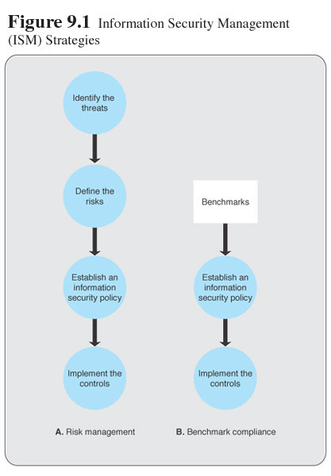

Slide 10
THREATS
An information security threat is a person, organization, mechanism, or event that can potentially inflict harm on the firm's information resources
Threats can be internal or external, accidental or intentional
Figure 9.2 shows the information security objectives and how they are subjected to the four types of risks:
    Internal and External Threats
    Accidental and Deliberate

Slide 11
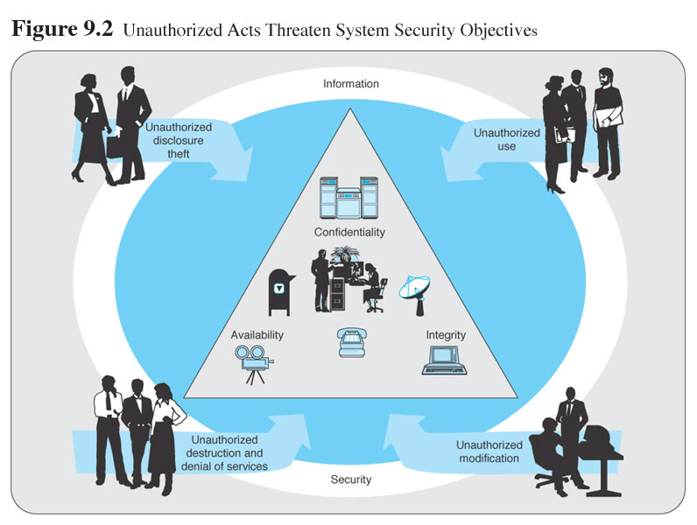

Slide 12
RISKS
Unauthorized acts that present risks can be categorized into four types:
Unauthorized Disclosure and Theft
  Unauthorized Use
  Unauthorized Destruction and Denial of Service
  Unauthorized Modification

Slide 13
THE MOST NOTORIOUS THREAT—THE “VIRUS”
A virus is a computer program that can replicate itself without the user’s knowledge
A worm can’t replicate itself within a system but can transmit copies of itself by e-mail
A Trojan horse can neither replicate nor distribute itself. Distribution is accomplished by users who distribute it as a utility that, when used, produces unwanted changes in the system's functionality

Slide 14
E-COMMERCE CONSIDERATIONS
E-commerce has introduced a new security risk: credit card fraud. Both American Express and Visa have implemented programs aimed specifically at e-commerce
American Express has announced "disposable" credit card numbers. These numbers, rather than the customer's credit card numbers, are provided to the e-commerce retailer, who submits it to American Express for repayment
Visa has announced ten security-related practices they expect their retailers to follow plus three general practices that retailers should follow (next slide)

Slide 15
Visa’s Security Precautions
Retailers must:
  Install and maintain a firewall
  Keep security patches up to date
  Encrypt stored data and transmitted data
  Use and update antivirus software
  Restrict data access to those with a need to know
  Assign unique IDs to persons with data access privileges
  Track data access with the unique ID
  Not use vendor-supplied password defaults
  Regularly test the security system
Retailers should:
  Screen employees who have access to data
  Not leave data (diskettes, paper, and so forth) or computers unsecured
  Destroy data when it is no longer needed

Slide 16
RISK MANAGEMENT
The four sub steps to defining information risks are:
  Identify business assets to be protected from risks
  Recognize the risks
  Determine the level of impact on the firm should the risks materialize
  Analyze the vulnerabilities of the firm
A systematic approach can be taken to sub steps 3 and 4 by determining the impact and analyzing the vulnerabilities
Table 9.1 illustrates the options.

Slide 17
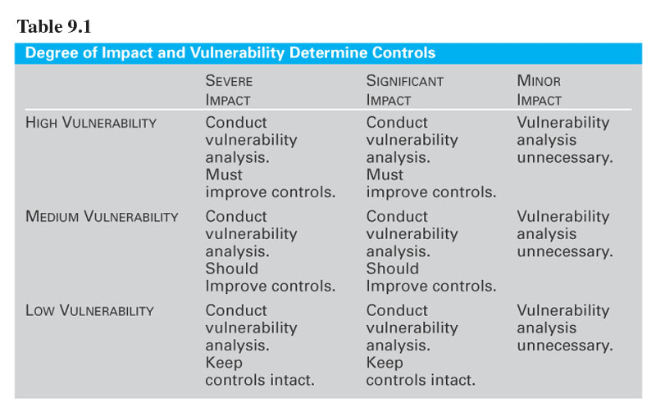

Slide 18
Risk Analysis Report
The findings of the risk analysis should be documented in a report that contains detailed information such as the following for each risk:
A description of the risk
Source of the risk
Severity of the risk
Controls that are being applied to the risk
The owner(s) of the risk
Recommended action to address the risk
Recommended time frame for addressing the risk
What was done to mitigate the risk

Slide 19
INFORMATION SECURITY POLICY
A security policy can be implemented using the following five phase approach (Fig. 9.3):
    Phase 1: Project Initiation
    Phase 2: Policy Development
    Phase 3: Consultation and Approval
    Phase 4:Awareness and Education
    Phase 5: Policy Dissemination

Slide 20
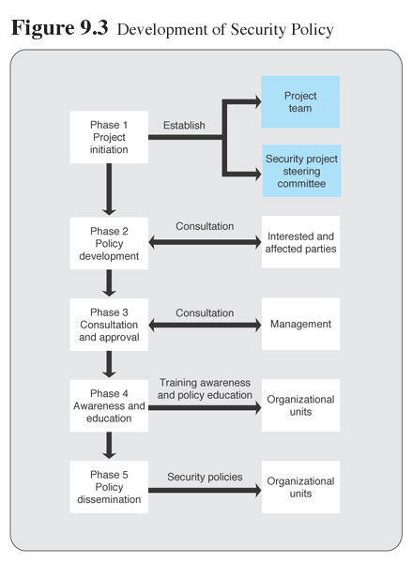

Slide 21
Separate policies are developed for:
Information systems security
System access control
Personnel security
Physical and environmental security
Telecommunications security
Information classification
Business continuity planning
Management accountability
These policies are distributed to employees, preferably in writing and in educational and training programs. With the policies established, controls can be implemented

Slide 22
CONTROLS
A control is a mechanism implemented to protect the firm from risks or minimize the impact of those risks on the firm should they occur:
  Technical controls are those built into systems by system developers during the system development life cycle
  Access control is the basis for security against threats by unauthorized persons
  Intrusion detection systems try to recognize an attempt to breach security before it has the opportunity to inflict damage

Slide 23
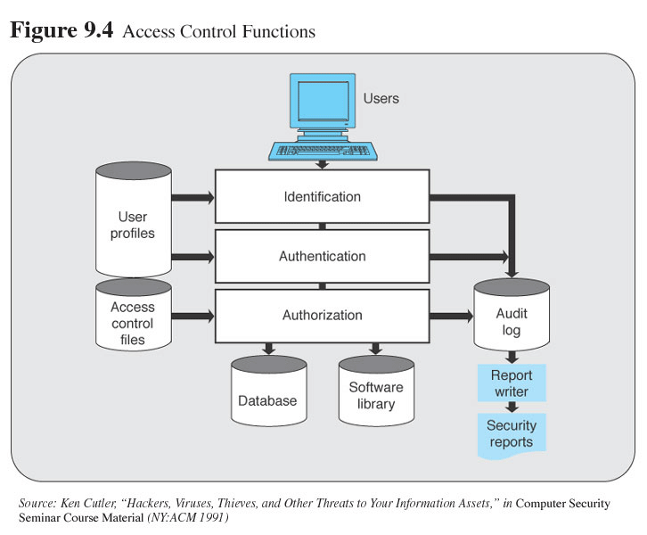

Slide 24
Access Control
User identification. Users first identify themselves by providing something that they know, such as a password
User authentication. Once initial identification has been accomplished, users verify their right to access by providing something that they have, such as a smart card or token, or an identification chip
User authorization. With the identification and authentication checks passed, a person can then be authorized certain levels or degrees of use. For example, one user might be authorized only to read from a file, whereas another might be authorized to make changes

Slide 25
Firewalls
A firewall acts as a filter and barrier restricting the data flowing between the firm’s network and the Internet
There are three types of firewalls:
  Packet-Filters – are routers equipped with data tables of IP addresses which reflect the filtering policy positioned between the Internet and the internal network, it can serve as a firewall
  Circuit-Level Firewall – installed between the Internet and the firm's network but closer to the communications medium
  Application-Level Firewall – located between the router and the computer performing the application

Slide 26
Cryptographic Controls
Cryptography is the use of coding by means of mathematical processes
The data and information can be encrypted as it resides in storage and or transmitted over networks
If an unauthorized person gains access, the encryption makes the data and information unreadable and prevents its unauthorized use
Special protocols such as SET (Secure Electronic Transactions) have been developed for use in e-commerce

Slide 27
FORMAL CONTROLS
Formal controls include the establishment of:
    Codes of conduct
    Documentation of expected procedures and practices
    Monitoring and preventing behavior that varies from the established guidelines
The controls are formal in that management:
    Devotes considerable time to devising them
    They are documented in writing
    They are expected to be in force for the long term

Slide 28
INFORMAL CONTROLS
Informal controls include such activities as:
Instilling the firm's ethical beliefs in its employees;
Ensuring an understanding of the firm's mission and objectives;
Education and training programs; and
Management development programs
These controls are intended to ensure that the firm's employees both understand and support the security program

Slide 29
ACHIEVING THE PROPER LEVEL OF CONTROLS
As all three types of controls, technical, formal, and informal - cost money
The idea is to establish controls at the proper level
The control decision boils down to cost versus return, but in some industries there are other considerations
In banking, when engaging in risk management for ATMs, controls must keep the system secure but not at the cost of diminishing customer convenience
In health care, the system should not be so secure as to reduce the amount of necessary patient information available to hospitals and physicians

Slide 30
GOVERNMENT AND INDUSTRY ASSISTANCE
Several governments and international organizations have established standards (next slide) intended to serve as guidelines for organizations seeking to achieve information security
Some are in the form of benchmarks, sometimes referred to as a baseline

Slide 31
Government and Industry Assistance
United Kingdom's BS7799 The UK standards establish a set of baseline controls. Both Australia and New Zealand have instituted controls based on BS 7799
BSI IT Baseline Protection Manual The baseline approach is also followed by the German Bundesamt fur Sicherheit in der Informationstechnik (BSI). The baselines are intended to provide reasonable security when normal protection requirements are intended. The baselines can also serve as the basis for higher degrees of protection when those are desired
COBIT COBIT, from the Information Systems Audit and Control Association & Foundation (ISACAF), focuses on the process that a firm can follow in developing standards, paying special attention to the writing and maintaining of the document
GASSP Generally Accepted System Security Principles (GASSP) is a product of the U. S. National Research Council. Emphasis is on the rationale for establishing a security policy
GMITS The Guidelines for the Management of IT Security (GMITS) is a product of the International Standards Organization (ISO) Joint Technical Committee and it provides a list of the information security policy topics that should be included in an organization's standards
ISF Standard of Good Practice The Information Security Forum Standard of Good Practice takes a baseline approach, devoting considerable attention to the user behavior that is expected if the program is to be successful

Slide 32
GOVERNMENT LEGISLATION
Governments in both the U.S. and U.K. have established standards and passed legislation aimed at addressing the increasing importance of information security:
  U.S. Government Computer Security Standards
  The U.K. Anti-terrorism, Crime and Security Act (ATCSA) 2001
  U.S. Government Internet Crime Legislation

Slide 33
INDUSTRY STANDARDS
The Center for Internet Security (CIS) is a non profit organization dedicated to assisting computer users to make their systems more secure
CIS Benchmarks have been established and are integrated in a software package that calculates a "security" score on a 10-point scale

Slide 34
PROFESSIONAL CERTIFICATION
Beginning in the 1960s the IT profession began offering certification programs:
  Information Systems Audit and Control Association (ISACA)
  International Information System Security Certification Consortium (ISC)
  SANS (SysAdmin, Audit, Network, Security) Institute

Slide 35
PUTTING INFORMATION SECURITY MANAGEMENT IN PERSPECTIVE
Firms should put in place an information security management policy before putting controls in place
The policy can be based on an identification of threats and risks or on guidelines provided by governments and industry associations
Firms implement a combination of technical, formal, and informal controls expected to offer the desired level of security within cost parameters and in accordance with other considerations that enable the firm and its systems to function effectively

Slide 36
BUSINESS CONTINUITY MANAGEMENT (BCM)
The key element in BCM is a contingency plan, formally detailing the actions to be taken in the event that there is a disruption, or threat of disruption, in any part of the firm’s computing operation
Rather using a single, large contingency plan, a firm’s best approach is to develop several sub-plans that address specific contingencies. Such as:
    An emergency plan
    A backup plan
    A vital records plan

Slide 37
PUTTING BUSINESS CONTINUITY MANAGEMENT IN PERSPECTIVE
Much effort has gone into contingency planning and much information and assistance is available
Some firms use packaged plans they can adapt to their needs
TAMP Computer Systems markets a Disaster Recovery System (DRS) that includes a database management system, instructions and tools that can be used in preparing a recovery plan
There are also guidelines and outlines that firms can use as starting points or benchmarks to achieve

Slide 38
END OF CHAPTER 9

