Slide 1
Management Information Systems, 10/e
Raymond McLeod Jr. and George P. Schell

Slide 2
Chapter 9
Information Security

Slide 3
Learning Objectives
Understand the organizational needs for information security and control.
Know that information security is concerned with securing all information resources, not just hardware and data.
Know the three main objectives of information security.
Know that management of information security consists of two areas: information security management (ISM) and business continuity management (BCM).
See the logical relationship among threats, risks and controls.
Know what the main security threats are.
Know what the main security risks are.

Slide 4
Learning Objectives (Cont’d)
Recognize the security concerns of e-commerce and how credit card companies are dealing with them.
Be familiar with a formal way to engage in risk management.
Know the process for implementing an information security policy.
Be familiar with the more popular security controls.
Be familiar with actions of government and industry that influence information security.
Know how to obtain professional certification in security and control.
Know the types of plans that are included in contingency planning.

Slide 5
Organizational Needs for Security and Control
Experience inspired industry to:
Place security precautions aimed at eliminating or reducing the opportunity of damage or destruction.
Provide the organization the ability to continue operations after disruption.
Patriot Act and the Office of Homeland Security
1st issue is security vs. individual rights.
2nd issue is security vs. availability (i.e., HIPPA).

Slide 6
Information Security
System security focuses on protecting hardware, data, software, computer facilities, and personnel.
Information security describes the protection of both computer and non-computer equipment, facilities, data, and information from misuse by unauthorized parties.
Includes copiers, faxes, all types of media, paper documents

Slide 7
Objectives of Information Security
Information security is intended to achieve three main objectives:
Confidentiality: protecting a firm’s data and information from disclosure to unauthorized persons.
Availability: making sure that the firm's data and information is only available to those authorized to use it.
Integrity: information systems should provide an accurate representation of the physical systems that they represent.
Firm’s information systems must protect data and information from misuse, ensure availability to authorized users, display confidence in its accuracy.

Slide 8
Management of Information Security
Information security management (ISM) is the activity of keeping information resources secure.
Business continuity management (BCM) is the activity of keeping the firm and its information resources functioning after a catastrophe.
Corporate information systems security officer (CISSO) is responsible for the firm’s information systems security.
Corporate information assurance officer (CIAO) reports to the CEO and manage an information assurance unit.

Slide 9
Information Security Management
Concerned with formulating the firm’s information security policy.
Risk management approach is basing the security of the firm’s information resources on the risks (threats imposed) that it faces.
Information security benchmark is a recommended level of security that in normal circumstances should offer reasonable protection against unauthorized intrusion.
Benchmark is a recommended level of performance.
Defined by governments and industry associations
What authorities believe to be components of a good information security program.
Benchmark compliance is when a firm adheres to the information security benchmark and recommended standards by industry authorities.

Slide 10
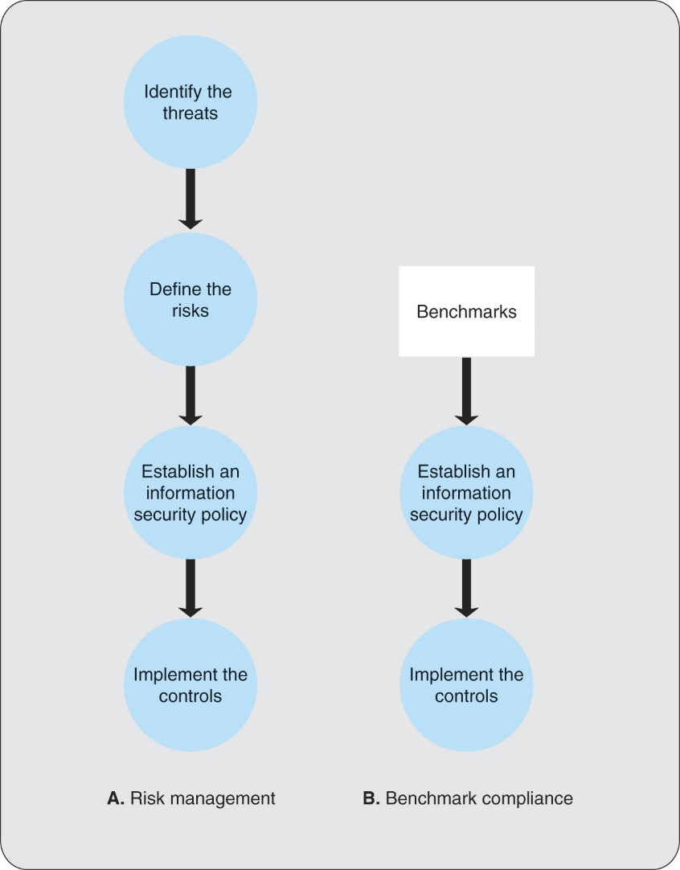
Figure 9.1 Information Security Management (ISM) Strategies

Slide 11
Threats
Information security threat is a person, organization, mechanism, or event that has potential to inflict harm on the firm’s information resources.
Internal and external threats
Internal include firm’s employees, temporary workers, consultants, contractors, and even business partners.
As high as 81% of computer crimes have been committed by employees.
Internal threats present potentially more serious damage due to more intimate knowledge of the system.
Accidental and deliberate acts

Slide 12
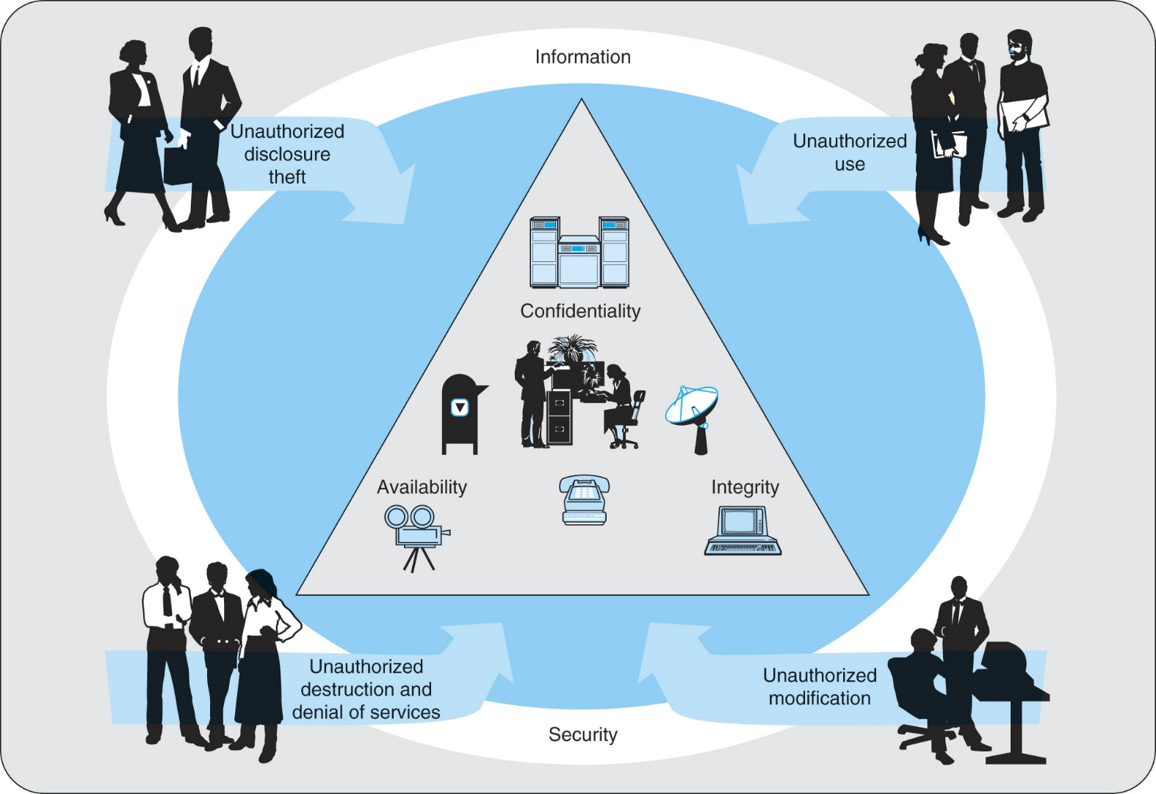
Figure 9.2 Unauthorized Acts Threaten System Security Objectives

Slide 13
Types of Threats
Malicious software (malware) consists of complete programs or segments of code that can invade a system and perform functions not intended by the system owners (i.e., erase files, halt system, etc.).
Virus is a computer program that can replicate itself without being observable to the user and embed copies of itself in other programs and boot sectors.
Worm cannot replicate itself within a system, but it can transmit its copies by means of e-mail.
Trojan horse is distributed by users as a utility and when the utility is used, it produces unwanted changes in the system’s functionality; can’t replicate nor duplicate itself.
Adware generates intrusive advertising messages.
Spyware gathers data from the user’s machine.

Slide 14
Risks
Information security risk is a potential undesirable outcome of a breach of information security by an information security threat.
all risks represent unauthorized acts.
Unauthorized disclosure and threats
Unauthorized use
Unauthorized destruction and denial of service
Unauthorized modifications

Slide 15
E-commerce Considerations
Disposable credit card (AMEX) – an action aimed at 60 to 70% of consumers who fear credit card fraud arising from Internet use.
Visa’s 10 required security practices for its retailers plus 3 general practices for achieving information security in all retailers’ activities.
Cardholder Information Security Program (CISP) augmented these required practices.

Slide 16
Risk Management
Defining risks consists of four substeps.
Identify business assets to be protected from risks.
Recognize the risks.
Determine the level of of impact on the firm should the risks materialize.
Analyze the firm’s vulnerabilities.
Impact severity can be classified as:
Severe impact puts the firm out of business or severely limits its ability to function.
Significant impact causes significant damage and cost, but the firm will survive.
Minor impact causes breakdowns that are typical of day-to-day operations.

Slide 17
Table 9.1 Degree of Impact and Vulnerability Determine Controls

Slide 18
Risk Analysis Report
The findings of the risk analysis should be documented in a report that contains detailed information such as the following for each risk:
A description of the risk
Source of the risk
Severity of the risk
Controls that are being applied to the risk
The owner(s) of the risk
Recommended action to address the risk
Recommended time frame for addressing the risk
What was done to mitigate the risk

Slide 19
Information Security Policy
The five phases of implementing:
Phase 1: Project Initiation.
Phase 2: Policy Development.
Phase 3: Consultation and Approval.
Phase 4:Awareness and Education.
Phase 5: Policy Dissemination.

Slide 20
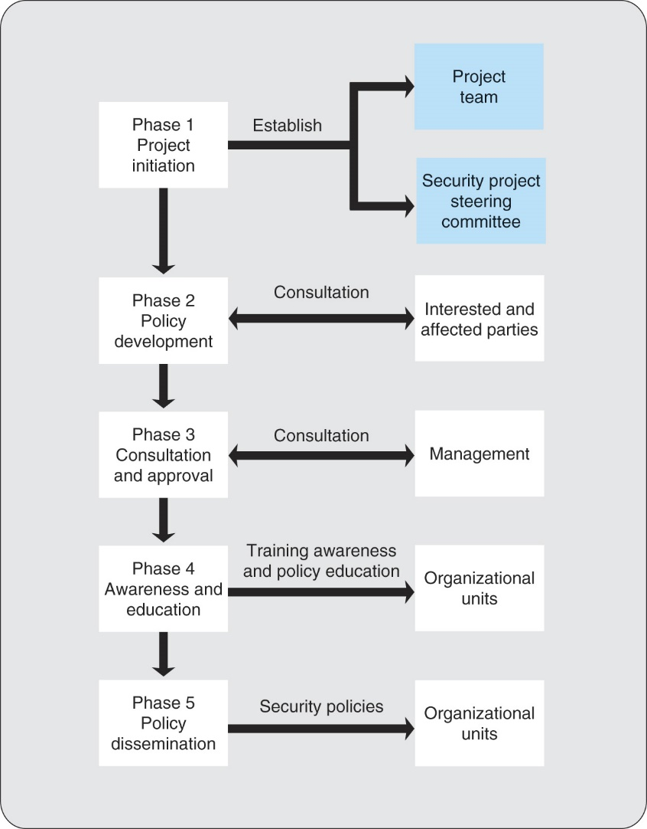
Figure 9.3 Development of Security Policy

Slide 21
Controls
Control is a mechanism that is implemented to either protect the firm from risks or to minimize the impact of risks on the firm should they occur.
Technical controls are those that are built into systems by the system developers during the systems development life cycle.
Include an internal auditor on project team.
Based on hardware and software technology.

Slide 22
Technical Controls
Access control is the basis for security against threats by unauthorized persons.
Access control three-step process includes:
User identification.
User authentication.
User authorization.
User profiles-descriptions of authorized users; used in identification and authorization.

Slide 23
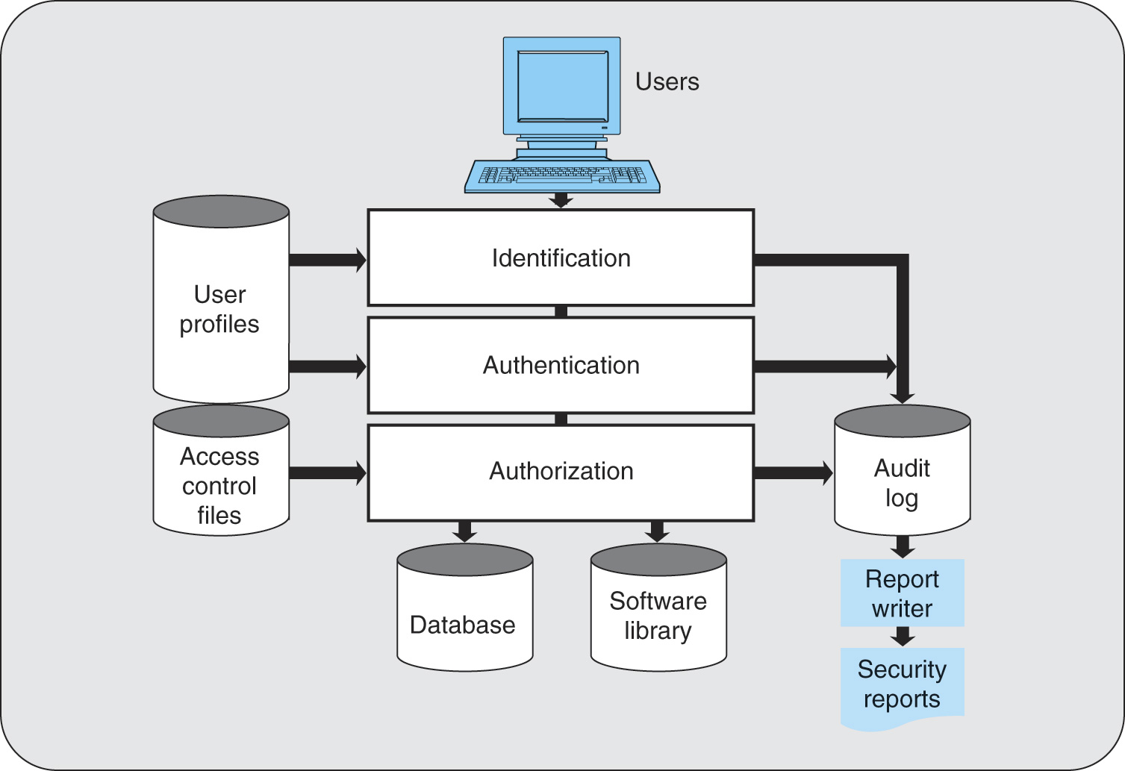
Figure 9.4 Access Control Functions

Slide 24
Technical Controls (Cont’d)
Intrusion detection systems (IDS) recognize an attempt to break the security before it has an opportunity to inflict damage.
Virus protection software that is effective against viruses transported in e-mail.
Identifies virus-carrying message and warns user.
Inside threat prediction tools classify internal threats in categories such as:
Possible intentional threat.
Potential accidental threat.
Suspicious.
Harmless.

Slide 25
Firewalls
Firewall acts as a filter and barrier that restricts the flow of data to and from the firm and the Internet. Three types of firewalls are:
Packet-filtering are routers equipped with data tables of IP addresses that reflect the filtering policy positioned between the Internet and the internal network, it can serve as a firewall.
Router is a network device that directs the flow of network traffic.
IP address is a set of four numbers (each from 0 to 255) that uniquely identify each computer connected to the Internet.
Circuit-level firewall installed between the Internet and the firm’s network but closer to the communications medium (circuit) than the router.
Allows for a high amount of authentication and filtering to be performed.
Application-level firewall located between the router and computer performing the application.
Allows for full power of additional security checks to be performed.

Slide 26
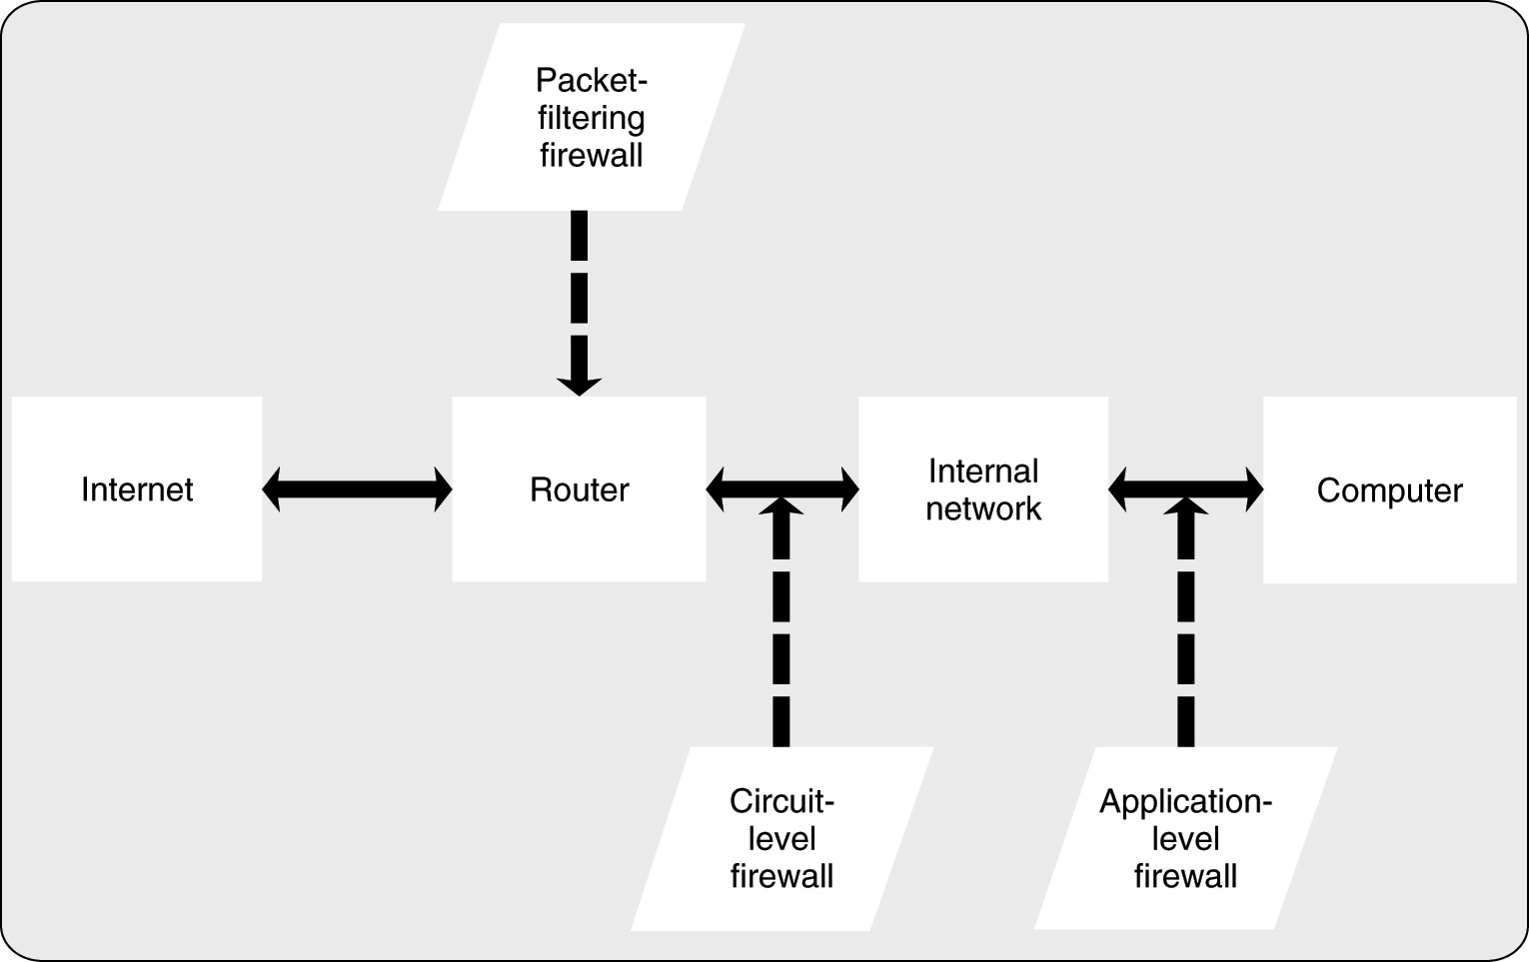
Figure 9.5 Location of Firewalls in the Network

Slide 27
Cryptographic and Physical Controls
Cryptography is the use of coding by means of mathematical processes.
The data and information can be encrypted as it resides in storage and or transmitted over networks.
If an unauthorized person gains access, the encryption makes the data and information unreadable and prevents its unauthorized use.
Special protocols such as SET (Secure Electronic Transactions) perform security checks using digital signatures developed for use in e-commerce.
Export of encryption technology is prohibited to Cuba, Iran, Iraq, Libya, North Korea, Sudan, and Syria.
Physical controls against unauthorized intrusions such as door locks, palm prints, voice prints, surveillance cameras, and security guards.
Locate computer centers in remote areas that are less susceptible to natural disasters such as earthquakes, floods, and hurricanes.

Slide 28
Formal Controls
Formal controls include the establishment of codes of conduct, documentation of expected procedures and practices, monitoring, and preventing behavior that varies from the established guidelines.
Management denotes considerable time to devising them.
Documented in writing.
Expected to be in force for the long term.
Top management must participate actively in their establishment and enforcement.

Slide 29
Informal Controls
Education.
Training programs.
Management development programs.
Intended to ensure the firm’s employees both understand and support the security program.
Good business practice is not to spend more for a control than the expected cost of the risk that it addresses.
Establish controls at the proper level.

Slide 30
Government and Industry Assistance
United Kingdom's BS7799. The UK standards establish a set of baseline controls. They were first published by the British Standards Institute in 1995, then published by the International Standards Organization as ISO 17799 in 2000, and made available to potential adopters online in 2003.
BSI IT Baseline Protection Manual. The baseline approach is also followed by the German Bundesamt fur Sicherheit in der Informationstechnik (BSI). The baselines are intended to provide reasonable security when normal protection requirements are intended. The baselines can also serve as the basis for higher degrees of protection when those are desired.
COBIT. COBIT, from the Information Systems Audit and Control Association and Foundation (ISACAF), focuses on the process that a firm can follow in developing standards, paying special attention to the writing and maintaining of the documentation.
GASSP. Generally Accepted System Security Principles (GASSP) is a product of the U. S. National Research Council. Emphasis is on the rationale for establishing a security policy.
ISF Standard of Good Practice. The Information Security Forum Standard of Good Practice takes a baseline approach, devoting considerable attention to the user behavior that is expected if the program is to be successful. The 2005 edition addresses such topics as secure instant messaging, Web server security, and virus protection.

Slide 31
Government Legislation
Both United States and United Kingdom established standards and passed legislation aimed at addressing the increasing importance of information security.
U.S. Government Computer Security Standards.
Set of security standards organizations should meet.
Availability of software program that grades users’ systems and assists them in configuring their systems to meet standards.
U.K. Anti-terrorism, Crime and Security Act (ATCSA) 2001.

Slide 32
Industry Standards
Center for Internet Security (CIS) is a nonprofit organization dedicated to assisting computer users to make their systems more secure.
CIS Benchmarks help users secure their information systems by implementing technology-specific controls.
CIS Scoring Tools enables users to calculate their security level, compare it to benchmarks, and prepare reports that guide users and system administrators to secure systems.

Slide 33
Professional Certification
Beginning in the 1960s the IT profession began offering certification programs:
Information Systems Audit and Control Association (ISACA)
International Information System Security Certification Consortium (ISC)
SANS (SysAdmin, Audit, Network, Security) Institute

Slide 34
Business Continuity Management
Business continuity management (BCM) are activities aimed at continuing operations after an information system disruption.
This activity was called disaster planning, then more positive term contingency planning.
Contingency plan is the key element in contingency planning; it is a formal written document that spells out in detail the actions to be taken in the event that there is a disruption, or threat of disruption, in any part of the firm’s computing operations.

Slide 35
Contingency Subplans
Emergency plan specifies those measures that ensure the safety of employees when disaster strikes.
Include alarm systems, evacuation procedures, and fire-suppression systems.
Backup plan is the arrangements for backup computing facilities in the event that the regular facilities are destroyed or damaged beyond use. Backup can be achieved by some combination of redundancy, diversity, and mobility.
Vital records are those paper documents, microforms, and magnetic and optical storage media that are necessary for carrying on the firm’s business.
Vital records plan specifies how the vital records will be protected and should include offsite backup copies.

