Slide 1
Management Information Systems, 10/e
Raymond McLeod Jr. and George P. Schell

Slide 2
Chapter 10
Ethical Implications of Information Technology

Slide 3
Learning Objectives
Understand how morals, ethics, and laws differ.
Be familiar with computer legislation that has been passed in the United States and know how legislation in one country can influence computer use in others as well.
Know how a firm creates an ethical culture by first establishing a corporate credo, then establishing ethics programs, and then lastly establishing a corporate ethics code.
Know why society demands that computers be used ethically.
Know the four basic rights that society has concerning the computer.

Slide 4
Learning Objectives (Cont’d)
Know how the firm’s internal auditors can play a positive role in achieving information systems that are designed to meet ethical performance criteria.
Be aware of computer industry codes of ethics, and the wide variety of educational programs that can help firms and employees use computers ethically.
Know what the chief information officer (CIO) can do to be a power center as the firm follows ethical practices.
Be acquainted with the most produced piece of legislation to be levied on business in recent history–The Sarbanes-Oxley Act.

Slide 5
Prescriptive vs. Descriptive Coverage
Prescriptive coverage is when we prescribe how the MIS ought to be developed and used in a business firm.
Descriptive coverage explains how things are being done.
Our mission is to recognize that businesspeople in general and information people in particular have definite responsibilities in terms of performing within ethical, moral, and legal constraints.

Slide 6
Morals, Ethics, and Laws
Morals are traditions of belief about right and wrong conduct; a social institution with a history and a list of rules.
Ethics is a collection of guiding beliefs, standards, or ideals that pervades an individual or a group or community of people.
Pirated software–software that is illegally copied and then used or sold.

Slide 7
Morals, Ethics, and Laws (Cont’d)
Laws are formal rules of conduct that a sovereign authority, such as a government, imposes on its subjects or citizens.
In 1966, first case of computer crime
Programmer for a bank altered a program not to flag his account for being overdrawn.
Programmer not charged because no laws existed.

Slide 8
Computer Legislation in U.S.A.
U.S. computer legislation has focused on rights and restrictions related to data access, information privacy, computer crime, and, most recently, software patents.
The 1966 Freedom of Information Act gave U.S. citizens and organizations the right to access data held by the federal government.
The 1970 Fair Credit Reporting Act dealt with the handling of credit data.
The 1978 Right to Federal Privacy Act limited the federal government’s ability to conduct searches of bank records.
The 1988 Computer Matching and Privacy Act restricted the federal government’s right to match computer files for the purpose of determining eligibility for government programs or identifying debtors.
The 1968 Electronics Communications Privacy Act covered only voice communications; rewritten in 1986 to include digital data, video communications, and electronic mail.

Slide 9
Computer Legislation in U.S.A. (Cont’d)
In 1984, U.S. Congress passed federal statutes that applied to computer crime.
The Small Business Computer Security and Education Advisory Council.
Advises Congress of matters relating to computer crime against small businesses.
Evaluate the effectiveness of federal and state crime laws in deterring and prosecuting computer crimes.

Slide 10
Computer Legislation in U.S.A. (Cont’d)
The Counterfeit Access Device and Computer Fraud and Abuse Act made it a federal felony for someone to gain unauthorized access to information pertaining to national defense or foreign relations.
Misdemeanor to gain unauthorized access to a computer protected by the Right to Financial Privacy Act or the Fair Credit Reporting Act and to misuse information in a computer owned by the federal government.

Slide 11
Software Patents
In July 1998, in the State Street Decision, the US Court of Appeals affirmed that a business process could be patented.
In April 2001, the U.S. Congress introduced a bill requiring a determination of the significance of the patent and whether it is appropriate for use with computer technology.
In this fashion, the U.S. federal government has gradually established a legal framework for computer use.
As with ethics, however, the computer laws can vary considerably from one country to the next.

Slide 12
Ethics Culture Concept
Ethics culture states that if a firm is to be ethical, then top-management must be ethical in everything that it does and says, i.e., lead by example.
Corporate credo is a succinct statement of values that the firm seeks to uphold.
Ethics program is an effort consisting of multiple activities designed to provide employees with direction in carrying out the corporate credo.

Slide 13
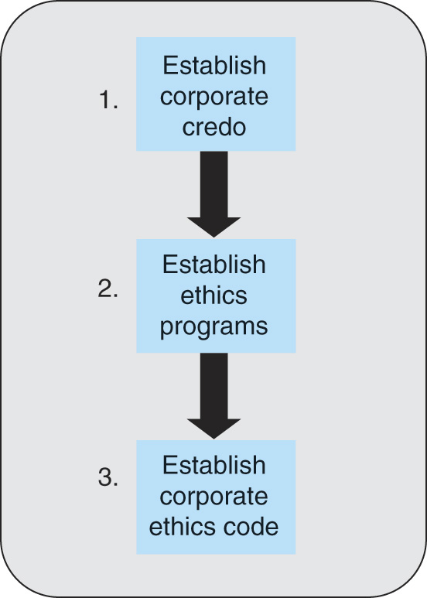
Figure 10.1 Top-Level Management Imposes Ethics Culture in a Top-Down Manner

Slide 14
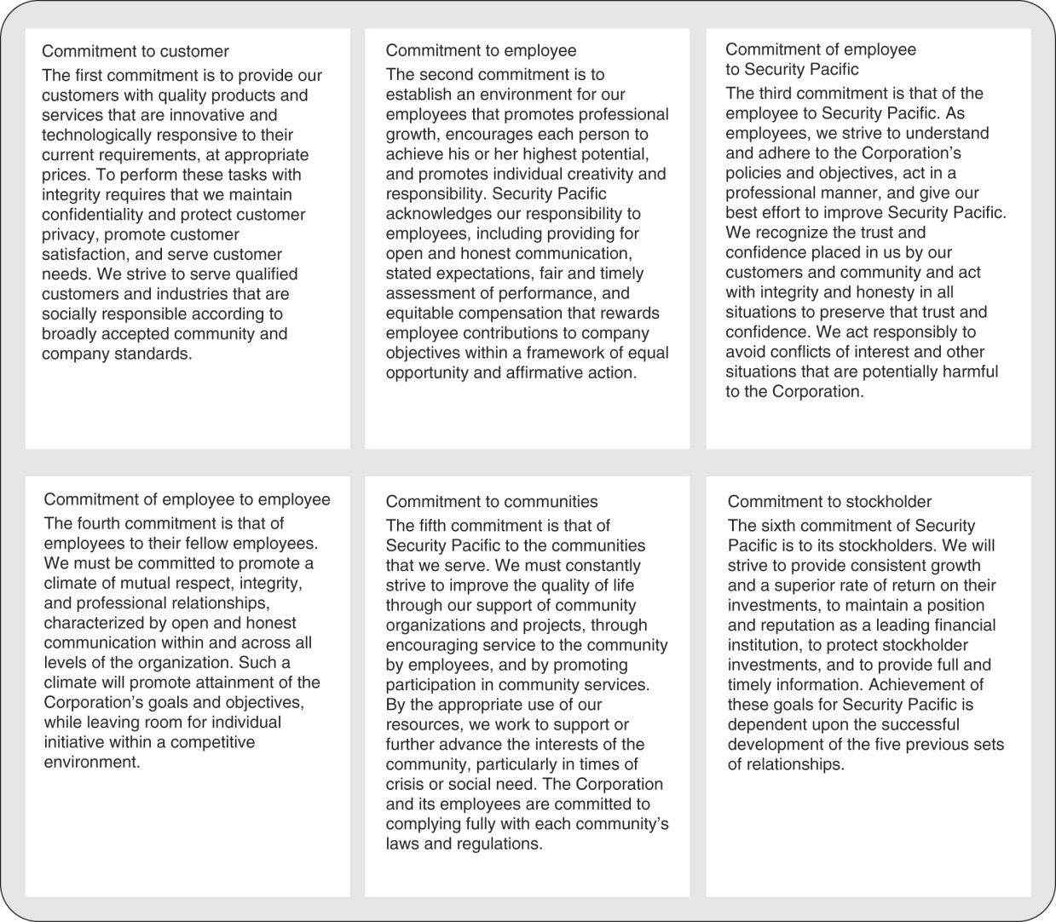
Figure 10.2 Example of a Corporate Credo

Slide 15
Ethics Culture Concept (Cont’d)
Ethics audit is when an internal auditor meets with a manager in a several-hour session for the purpose of learning how the manager’s unit is carrying out the corporate credo.
Tailored corporate credo are usually adaptations of codes for a particular industry or profession that a firm has devised for their own corporate credo.

Slide 16
Computer Ethics
Computer ethics consists of two main activities:
Analysis of the nature and social impact of computer technology; and
Formulation and justification of policies for the ethical use of such technology.
The CIO must:
Be alert to the effects that the computer is having on society; and
Formulate policies to ensure that the technology is used throughout the firm in the right way.

Slide 17
Reasons for the Importance of Computer Ethics
James H. Moor believes there are three main reasons for the high level of interest in computer ethics:
Logical Malleability: The computer performs exactly as instructed, so if it’s used for an unethical activity the computer is not the culprit.
The Transformation Factor: Computers can drastically change the way we do things.
The Invisibility Factor: Internal operations provides the opportunity for invisible programming values, invisible complex calculations, and invisible abuse.

Slide 18
Social Rights and the Computer
Mason coined the acronym PAPA (privacy, accuracy, property, and accessibility) to represent society’s four basic rights in terms of information.
Mason felt that “the right to be left alone” is being threatened by two forces:
the increasing ability of the computer to be used for surveillance.
the increasing value of information in decision making.
For example, decision makers place such a high value on information that they will often be willing to invade someone’s privacy to get it.

Slide 19
More Rights …
Right to Accuracy: the potential for a level of accuracy that is unachievable in noncomputer systems; some computer-based systems contain more errors than would be tolerated in manual systems.
Right to Property: copyright and patent laws provide some degree of protection.
Right to Access: much information has been converted to commercial databases, making it less accessible to the public.

Slide 20
Information Auditing
External auditors from outside the organization verify the accuracy of accounting records of firms of all sizes.
Internal auditors perform the same analyses as external auditors but have a broader range of responsibilities.
Audit committee defines the responsibilities of the internal auditing department and receives many of the audit reports.
Director of internal auditing manages the internal auditing department and reports to the CEO or the CFO.

Slide 21
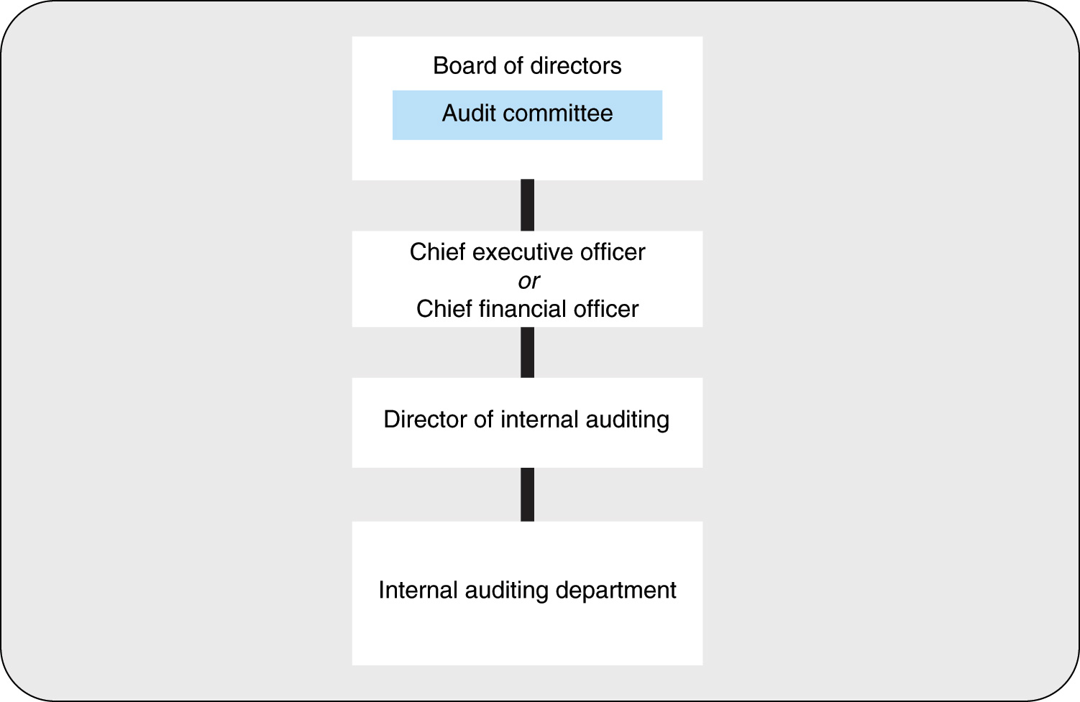
Figure 10.3 The Position of Internal Auditing in the Organization

Slide 22
Types of Auditing Activity
Internal auditors offer more objectivity since their only allegiance is to the board, the CEO, and the CFO.
Four basic types of internal auditing activity:
A financial audit: verifies the accuracy of the firm’s records and is the type of activity performed by external auditors.
An operational audit: aimed to validate the effectiveness of procedures including adequacy of controls, efficiency, and compliance with company policy. Systems analyst does in SDLC analysis stage.
A concurrent audit: is the same as an operational audit except that the concurrent audit is ongoing.
Internal Control Systems Design: the cost of correcting a system flaw increases dramatically as the system life cycle progresses (Figure 10.4).

Slide 23
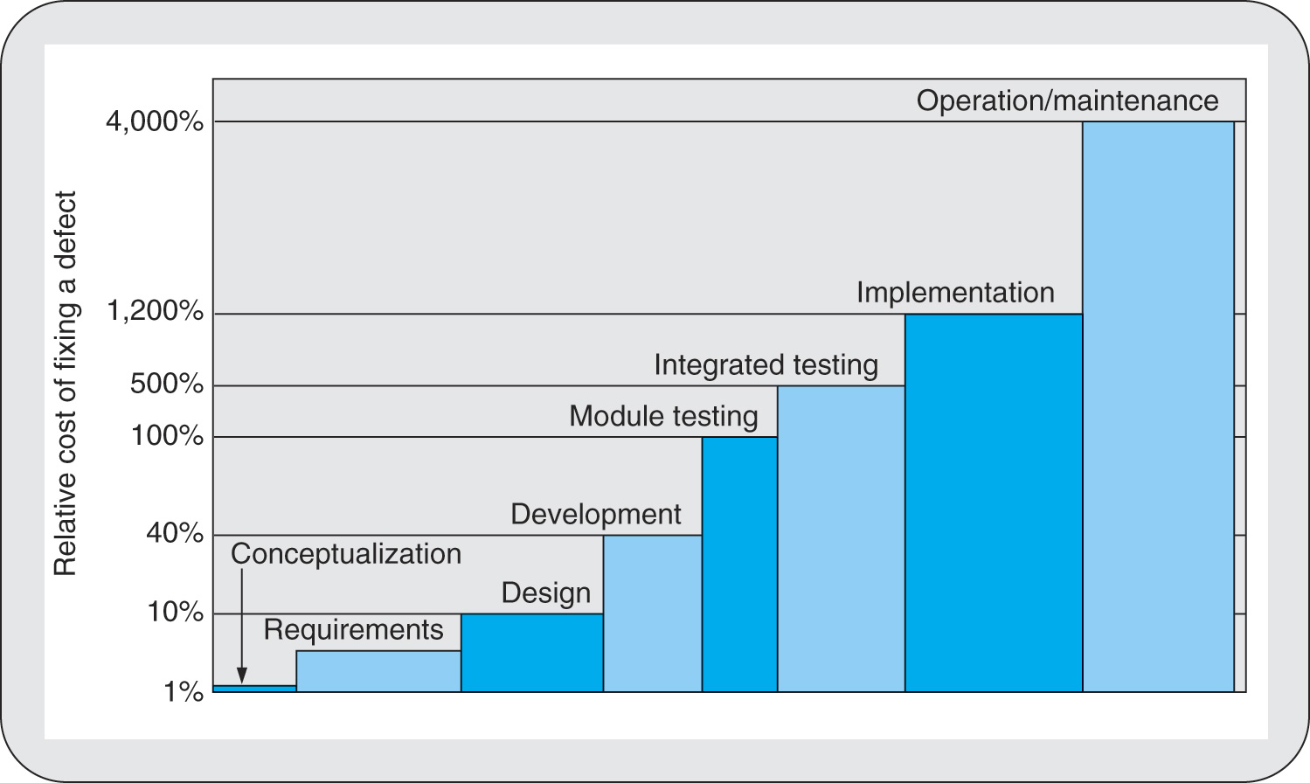
Figure 10.4 The Escalating Cost of Correcting Design Errors as the System Development Life Cycle Progresses

Slide 24
Internal Audit Subsystem
In the financial information system, the internal audit subsystem is one of the input subsystems.
Including internal auditors on systems development teams is:
A good step toward having well-controlled systems, and the systems are:
A good step toward giving management the information it needs to achieve and maintain ethical business operations.

Slide 25
Achieving Ethics in Information Technology
Ethic codes and ethics educational programs can provide the foundation for the culture.
Educational programs can assist in developing a corporate credo and in putting ethics programs in place.
Ethic codes can be used as is or can be tailored to the firm.

Slide 26
Codes of Ethics
ACM Code of Ethics and Professional Conduct.
Adopted in 1992.
Consists of 24 “imperatives”, i.e., statements of personal responsibility.
Code is subdivided into four parts.
General moral imperatives.
More specific professional responsibilities.
Organizational leadership imperatives.
Compliance with the code.

Slide 27
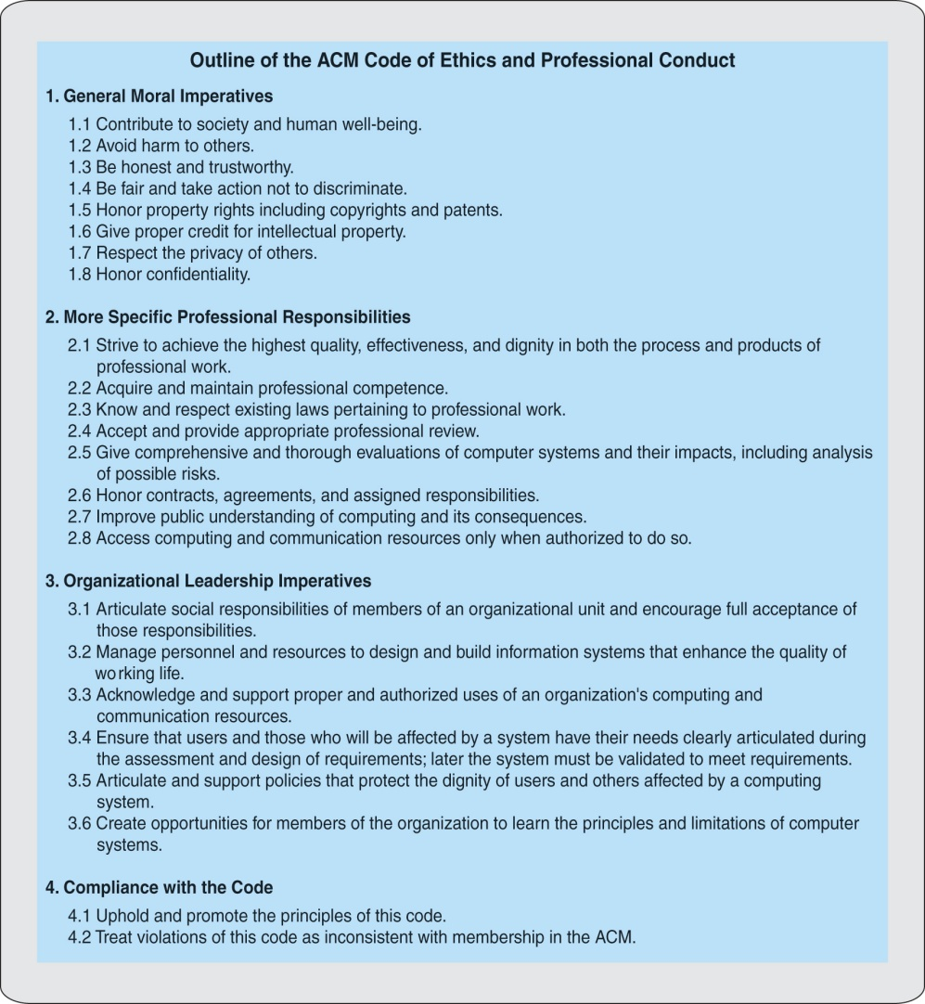
Figure 10.5 Outline of the ACM Code of Ethics and Professional Conduct

Slide 28
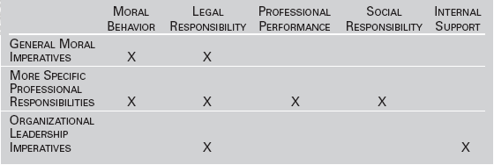
Table 10.1 Topics Covered by the ACM Code of Ethics and Professional Conduct

Slide 29
Table 10.2 Topics Covered by the ACM Software Engineering Code of Ethics and Professional Practice

Slide 30
ACM Software Engineering Code of Ethics and Professional Practice
This code consists of expectations in eight major areas:
Public
Client and employer
Product
Judgment
Management
Profession
Colleagues
Self

Slide 31
Computer Ethics Education
College courses–ACM developed a model computing curriculum of courses that should be offered.
Professional programs–AMA, Amer. Mgt. Assoc., offers special programs addressing ethics and integrity.
Private educational programs–LRN, the Legal Knowledge Co., offers Web-based course modules that address a wide range of ethical and legal issues.

Slide 32
Ethics and the CIO
As of August 11, 2002, CEOs and CFOs are required to sign off on the accuracy of their financial statements.
This requirement puts responsibility on the executives but also on the corporate information services unit and the information services units of the business areas to provide the executives with information that is accurate, complete, and timely.
Information Systems are only one unit in the organizational structure but it is in a key position to have the most influence on satisfying the demands of both government and society for accurate financial reporting.

Slide 33
Ethics and the CIO (Cont’d)
The CIO can bring financial reporting up to expectations by following a program that includes the following:
Achieving a higher level of understanding of accounting principles.
Reviewing the information systems that accomplish financial reporting and taking remedial action.
Educating the firm's executives on financial systems.
Integrating alarms into information systems that alert executives to activities that require attention.
Actively participating in the release of financial information to environmental elements.
Keeping tight control on money spent for information resources.

Slide 34
Life under Sarbanes-Oxley
The objective of Sarbanes-Oxley, known as SOX, is to protect investors by making the firm’s executives personally accountable for the financial information that is provided to the firm’s environment, primarily stockholders and the financial community.
SOX consists of 10 major provisions, 2 directly affect the firm’s information services unit.
CEOs and CFOs must certify the financial reports.
U.S. companies are required to have internal audit units.

Slide 35
SOX Provisions Affecting Information Services, Resources, and IT
SOX 404 – CIO must ensure that SOX imposed control requirements are built into systems during systems development and activities should include:
Identifying systems that play a role in financial reporting
Identifying the risks faced by these systems
Developing controls that address the risks
Documenting and testing the controls
Monitoring the effectiveness of the controls over time
Updating the controls as needed

Slide 36
SOX Provisions … (Cont’d)
SOX 409–firm must be able to report changes in its financial condition in real time–as the changes occur.
Should feature online inputs.
Output subsystems should be capable of immediately reporting changes in the firm’s financial condition.
SOX and COBIT
COBIT is an industry organization that provides security standards for the firm’s information resources.
COBIT can assist the firm in addressing its SOX responsibilities because COBIT standards align very well with the SOX expectations.
COBIT has 47,000 members worldwide, its financial reporting standards can have a global effect.

